Slide 1
Cross Cultural Communication
A Communication Skills Presentation

Slide 2
Contents
Objectives :
Understand culture and its constituents;
Interpret the differences between different cultures;
Synthesize strategies for handling cross-cultural communication.
Structure :
Introduction
Characteristics of Culture
Cross-Cultural Communication
Cross-cultural Communication Barriers
Overcoming Cross-cultural Communication Barriers
References and Further Readings

Slide 3
Introduction

Slide 4
Introduction
Culture has a complicated manifestation, especially with the world consisting of nationalities exhibiting cultures that lie on extremes of the continuum of measuring culture.
Hence, command on cross-cultural communication offers an edge to organisational supremacy. The most interesting aspect of culture is that even though it has a complex constitution, there is an evident pattern that can be discovered and interpreted.
“Cultura '' the Latin word meaning care of body, predominantly mind, is the source of the present word Culture. Culture is a complex compilation of beliefs, customs, law, knowledge, traditions, etc. that a human being acquires while being a member of a particular society. Culture is something we experience by aligning to the people who have been a part of the culture. The most common definitions of culture include music, art and theatre as the integral parts. Culture could exist in various macro and micro systems.

Slide 5
Characteristics of Culture

Slide 6
Characteristics of Culture
There are certain characteristics of culture which define it. These are :
Acquired
Collective
Value system
Stability
Differentiator
Contextual
Common yet different

Slide 7
Cross-Cultural Communication

Slide 8
Cross-Cultural Communication
Definition of cross-cultural communication
It is the study of understanding the differences and similarities of different cultural groups so as to effectively participate within an organisation. In other words, it refers to the adaptations done by the people from different cultural backgrounds to make the communication effective.
Need for Cross-Cultural Communication
The ability to adapt, irrespective of cultural values, makes a lot of difference. While communicating with the individuals or groups from varied cultural backgrounds, the transmission of knowledge and the behaviour play an important role. It is therefore important to comprehend how culture affects communication in turn affecting organisational operations.
Elements of cross-cultural communication
Awareness
Preparation
Language
Humour
Openness

Slide 9
Cross-Cultural Communication Barriers

Slide 10
Cross-Cultural Communication Barriers
Observation and interpretation are distinct when viewed in reference to cross- cultural communication (Barna, 1982). Barriers in cross-cultural communication can be classified under five heads as given by (Hofstede,2010).
These are as follows:
Language barrier
Nonverbal communication
Stereotypes
Cultural Bias
Anxiety

Slide 11
Overcoming Cross-cultural Communication Barriers

Slide 12
Overcoming Cross-cultural Communication Barriers
Cross-cultural communication stands as a process which not only identifies and addresses differences but also similarities amongst cultural groups so as to effectively engage within a given context.
It is more about adjustments that individuals belonging to different cultural backgrounds make in order to improve interpersonal and inter group communication.
In order to collectively reduce all barriers to cross-cultural communication it is best to be more patient and tolerant during all steps of communication. Approaching with an open mind, without any prejudice helps both parties.
The most ideal act will be to pause during the complete process of communication, beginning from perception, responding.interpretation and evaluation and most essentially before Flexibility in thought and action are the prerequisites for success today.

Slide 13
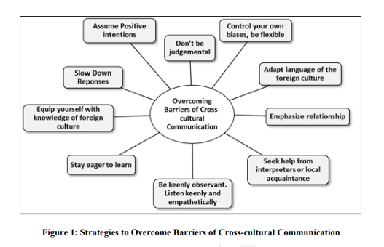
Overcoming Cross-cultural Communication Barriers Continued…

Slide 14
References and Further Readings

Slide 15
References and Further Readings
Barna, LaRay (1982). “Stumbling Blocks in Intercultural Communication.” In Intercultural Communication: A Reader, 330–38, edited by Larry Samovar & Richard Porter. Belmont, CA: Wadsworth.
Brian J. Hurn and Barry Tomalin (2013). Cross-Cultural Communication.Theory and Practice. Palgrave Macmillan.
Hofstede, G. H. (2001). Culture’s consequences: Comparing values, behaviors, Sage. institutions and organisations across nations. Thousand Oaks:
Hofstede, G. H. (2013). National Culture. Retrieved from: http://geert- hofstede.com/national-culture.html 248 Ngin Kulich, S. J. & Condon, J. C. (2015). Culture and communication: Cross-Cultural Celebrating a centennial of E. T. Hall’s contributions. The FutureLearn Intercultural Communication Course. Shanghai, China: Shanghai International Studies University.
Lengel, R.H. and R.L. Daft (1989).The Selection of Communication Media as an Executive Skill. Academy of Management Executive, 2, 3, 225-232.
Tomalin, B. and Nicks, M. (2010).The World’s Business Cultures and How to Unlock Them (London: Thorogood Publishing).
Yunxia Zhu, Pieter Nel& Ravi Bhat (2006).A Cross-cultural Study of Communication Strategies for Building Business Relationships.International Journal of Cross-cultural Management, 6; 319.

Slide 16
Cross Cultural Communication
Presented By Joy Talukder
M.Sc. Computer Science
Department of Computer Science
Banaras Hindu University

Slide 17
Thank You

